Slide 1
Interaction Diagrams

Slide 2
1. Sequence Diagram
2. Collaboration Diagram
These diagram are used to describe some type of interactions among the different elements in the model.
This interaction is a part of dynamic behavior of the system.
The basic purpose of both the diagrams are similar.

Slide 3
Purpose
visualize the interactive behavior of the system.
To capture the dynamic behaviour of a system.
To describe the message flow in the system.
To describe the structural organization of the objects.
To describe the interaction among objects.

Slide 4
Sequence Diagram
Sequence diagram emphasizes on time sequence of messages
Used to understand logical flow of the system

Slide 5
A Sequence Diagram
member:
LibraryMember
book:Book
:Book
Copy
borrow(book)
ok = mayBorrow()
[ok] borrow(member)
setTaken(member)
Sequence Diagrams

Slide 6
A Sequence Diagram
X-Axis (objects)
member:
LibraryMember
book:Book
:Book
Copy
borrow(book)
Object
Life Line
Y-Axis (time)
ok = mayBorrow()
message
Focus of comtrol
[ok] borrow(member)
setTaken(member)
condition
Sequence Diagrams

Slide 7
Object
Object naming:
  syntax: [instanceName][:className]
  Name classes consistently with your class diagram (same classes).
  Include instance names when objects are referred to in messages or when several objects of the same type exist in the diagram.
The Life-Line represents the object’s life during the interaction
myBirthdy
:Date
Sequence Diagrams

Slide 8
Messages
An interaction between two objects is performed as a message sent from one object to another (simple operation call, Signaling, RPC)
If object obj₁ sends a message to another object obj₂ some link must exist between those two objects (dependency, same objects)
Sequence Diagrams

Slide 9
Messages (Cont.)
A message is represented by an arrow between the life lines of two objects.
  Self calls are also allowed
  The time required by the receiver object to process the message is denoted by an activation-box.
A message is labeled at minimum with the message name.
  Arguments and control information (conditions, iteration) may be included.
Sequence Diagrams

Slide 10
Return Values
Optionally indicated using a dashed arrow with a label indicating the return value.
  Don’t model a return value when it is obvious what is being returned, e.g. getTotal()
  Model a return value only when you need to refer to it elsewhere, e.g. as a parameter passed in another message.
  Prefer modeling return values as part of a method invocation, e.g. ok = isValid()
Sequence Diagrams

Slide 11
Synchronous Messages
Nested flow of control, typically implemented as an operation call.
  The routine that handles the message is completed before the caller resumes execution.
:A
:B
doYouUnderstand()
return (optional)
Caller Blocked
yes
Sequence Diagrams

Slide 12
Object Creation
An object may create another object via a <<create>> message.
Preferred
:A
:B
:A
<<create>>
<<create>>
:B
Constructor
Sequence Diagrams

Slide 13
Object Destruction
An object may destroy another object via a <<destroy>> message.
  An object may destroy itself.
  Avoid modeling object destruction unless memory management is critical.
:A
:B
<<destroy>>
Sequence Diagrams

Slide 14
Control information
Condition
  syntax: ‘[‘ expression ’]’ message-label
  The message is sent only if the condition is true
  example:
Iteration
  syntax: * [ ‘[‘ expression ‘]’ ] message-label
  The message is sent many times to possibly multiple receiver objects.
[ok] borrow(member)
Sequence Diagrams

Slide 15
Common Uses
Interaction diagrams can be used −
To model the flow of control by time sequence.
To model the flow of control by structural organizations.

Slide 16
What is a Collaboration Diagram
Collaboration diagrams illustrate interactions between objects
The collaboration diagram illustrates messages being sent between classes and objects (instances).
Collaboration diagrams express both the context of a group of objects (through objects and links) and the interaction between these objects (by representing message broadcasts)

Slide 17
Purpose of the Collaboration Diagram
They are very useful for visualizing the relationship between objects collaborating to perform a particular task
They provide a good view – albeit static - view of interaction between objects which may be difficult to see at the class level

Slide 18
Collaboration Diagram
Represents a Collaboration and Interaction
Collaboration­set of objects and their interactions in a specific context
Interaction­set of messages exchanged in a collaboration to produce a desired result

Slide 19
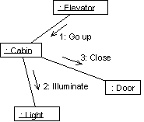
Ex. Collaboration Diagram

Slide 20
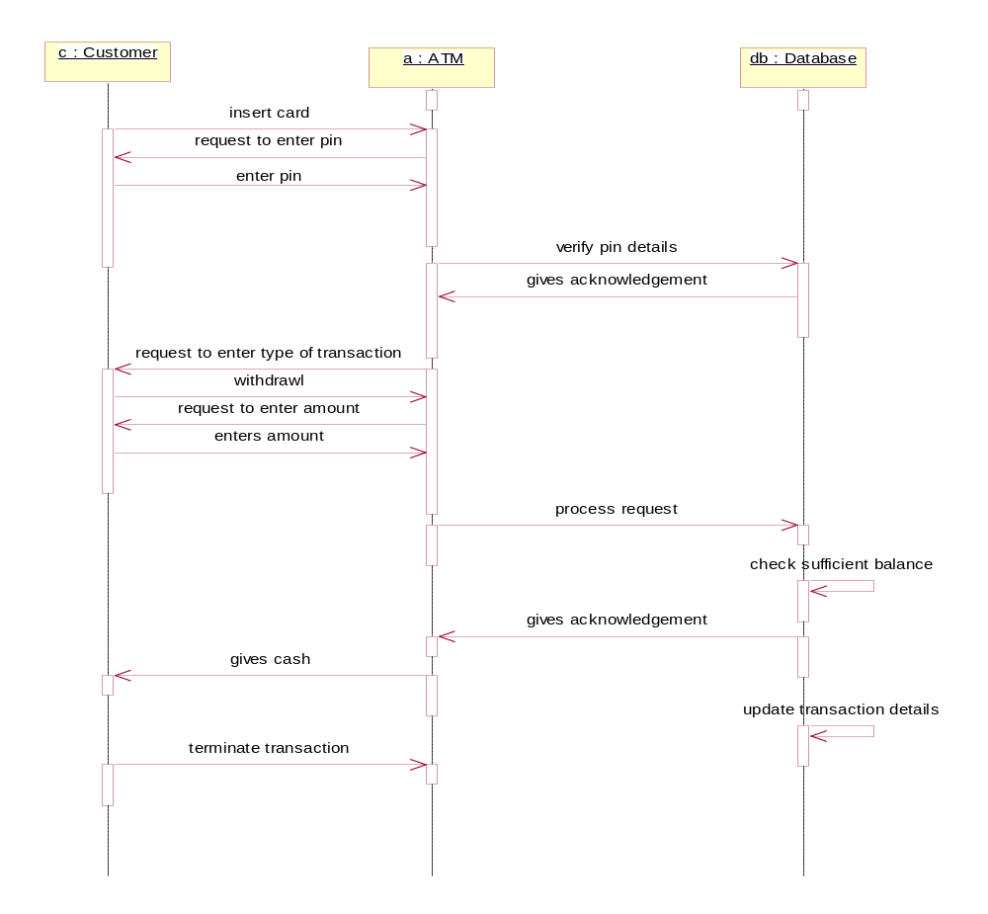

Slide 21
